Slide 1



STUDENT MANAGEMENT SYSTEM
BY :
NIRANJANA Y(23CDR110)
MUTHAMIL S(23CDR104)

Slide 2
Problem Description
Managing student data manually is time-consuming, error-prone, and inefficient.
A Student Management System is needed to automate tasks like storing student details, tracking attendance, managing grades, and handling course enrollment.
This system will improve accuracy, save time, and provide secure, easy access to information for students, teachers, and administrators.

Slide 3
Objectives
Improve Data Accuracy and Access
Automate Student Records
Simplify Academic Management
Monitor Attendance Easily
Generate Reports
Enhance Communication
Ensure Data Security
Track Student Progress Over Time
3

Slide 4
Tech Stack
FRONT END : HTML,CSS
BACK END : PYTHON
DATABASE : MYSQL
DATABASE CONNECTION : PYTHON FLASK
4

Slide 5
Proposed System
Course & Enrollment Management : Enables students to register for courses and administrators to manage course offerings and schedules.
Attendance Tracking : Automates daily attendance recording and provides reports for both students and staff.
Marks & Grade Management : Allows teachers to enter grades, calculate results, and generate academic reports.

Slide 6
Advantage
Centralized Data
Data Accuracy
Security and Role-Based Access
Disadvantage
Requires Internet and Power
Maintenance and Updates

Slide 7
Feasibility
Technical Feasibility
The system can be developed using existing technologies (e.g., web frameworks, databases, servers).
Required hardware and software tools are readily available.
Operational Feasibility
Staff, students, and faculty can adapt to the system after training.
Enhances overall efficiency and communication in the institution.
The system simplifies and speeds up administrative tasks.
Economic Feasibility
Initial development or purchase may require investment in software, hardware, and training.

Slide 8
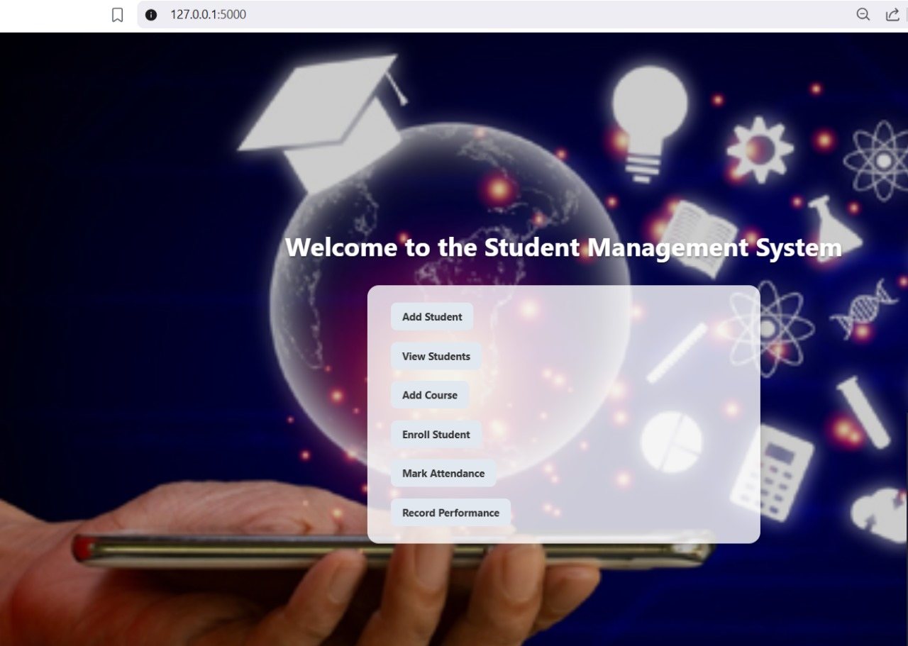
Implementation details
1.LOGIN
1.1 SIGNUP
2.INDEX PAGE
2.1 ADD STUDENT
2.2 VIEW STUDENTS
2.3 ADD COURSE
2.4 ENROLL STUDENTS
2.5 MARK ATTENDANCE
2.6 RECORD PERFORMANCE

Slide 9
1. Frontend
Features:
• Clean and organized HTML templates
• Forms for user input with server-side validation via Flask.
• Role-specific pages for students and staff.
• Bootstrap for consistent layout, responsive grids, and styled buttons/forms.
• URL routing for seamless page navigation.

Slide 10
Backend
Server-side form handling and validation to ensure data correctness.
Session management for user login persistence across pages.
MySQL database integration using mysql.connector for real-time data storage and retrieval.
Templates integrated with Bootstrap for clean and mobile-friendly UI.
Structured URL routing for seamless navigation across pages (/login, /signup, /add_student, /view_students, /mark_attendance, etc.).

Slide 11
Database
Stores users (students) securely with hashed passwords.
Keeps records of students, courses, enrollments, attendance, and grades.
Links students and courses using IDs.Makes it easy to:Add new students and courses.
Enroll students into courses.Mark attendance.Record performance (grades).
Organized into separate tables to avoid confusion.

Slide 12
Types of Modules
Student Management Module
Management Enrollment Module
Attendance Management Module
Mark attendance Module
Performance Tracking Module
12

Slide 13
Thank you!

